Slide 1
How is art connected to science 🧬🎨
Exhibition
By Filip Zifra 22ndApril, 2020

Slide 2
Central idea, lines of inquiry and key concept
My central idea is Meaning and perception of visual art changing throughout history.
My lines of inquiry What is the connection between science and art.
My key concept is Existence of connection between them

Slide 3
Mar 16 2016
Introduction
Are science and art even remotely related?
Is there any connection between them?
Are there any facts to back down connection claim?

Slide 4
What’s interesting about art and science combined
Art training helps scientists excel
Science gets improved, by enabling scientist to draw more accurate representations of water swirling around objects, and the movements of clouds. ... Medical professionals may also find that training in the visual arts can help them in their jobs.
There’s a thing called The golden ratio, it’s even found on the Mona Lisa’s face

Slide 5
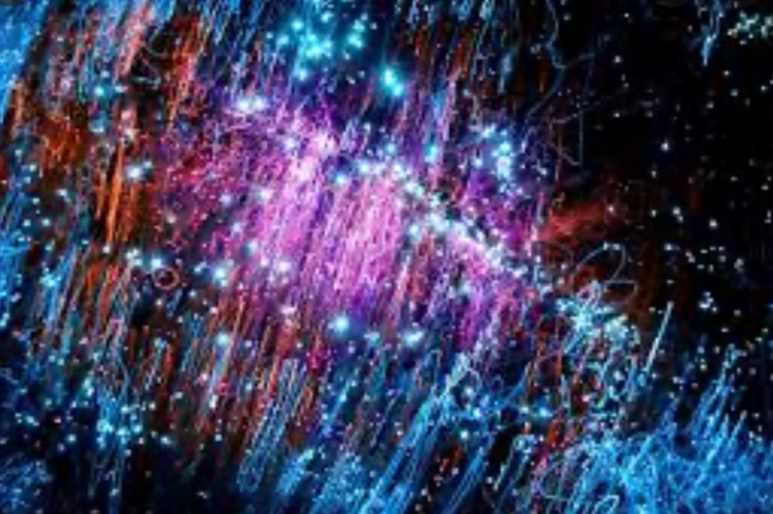
When science meets art
When art and science meet it makes really cool pictures that artists and scientists can’t make, but when they meet each other, it makes some thing really nice like this picture
People can make science and art meet, but not a lot of people (what to see and do, how is it going to form together).Here's a video when science and art meet:

Slide 6
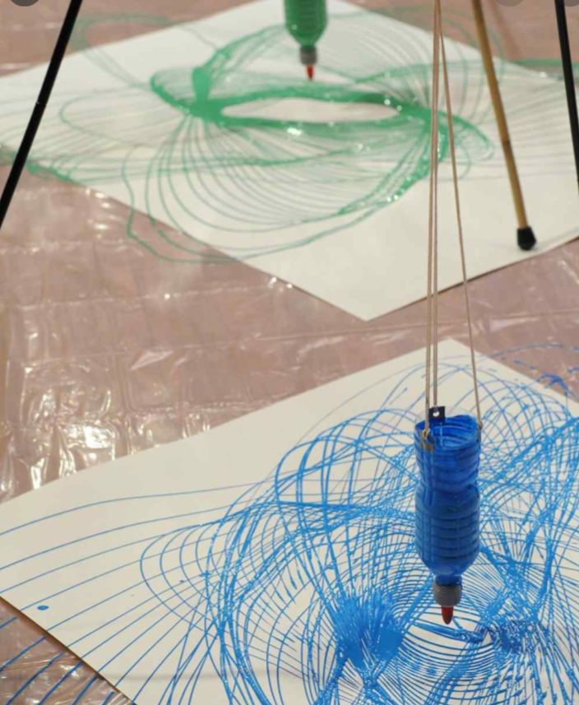
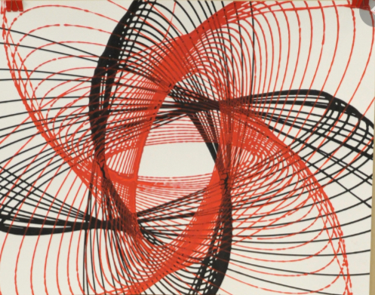
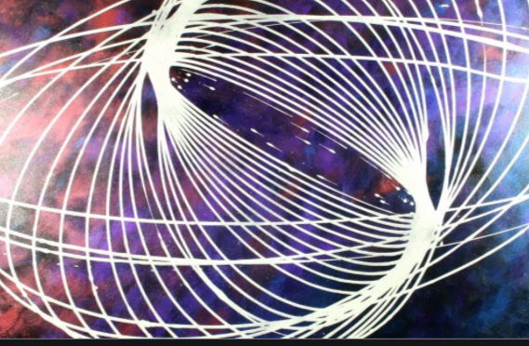
Pendulum panting
There is art like Pendulum Painting.
Pendulum painting is like you have a cup with a hole and you put colors in the cup and you put under the cup a big paper and then you push it around and it will make a cool looking drawing- here’s a picture of it->
Here are some pictures

Slide 7
Facts
Did you know that Pendulum panting can take up to 45 minutes to make, 30 to set it all up and 15 for the painting?
Did you know that Jim Fuggly made Pendulum panting he tried to make some kind of art to combine science and art?
In 1851, Jean Bernard Leon Foucault used a long pendulum to make the first conclusive demonstration of the Earth's rotation.
The pendulum was free to swing in any direction with respect to its support and had a bob that traced a line in loose sand on each swing.
Did you know that math is used in some art pictures?

Slide 8
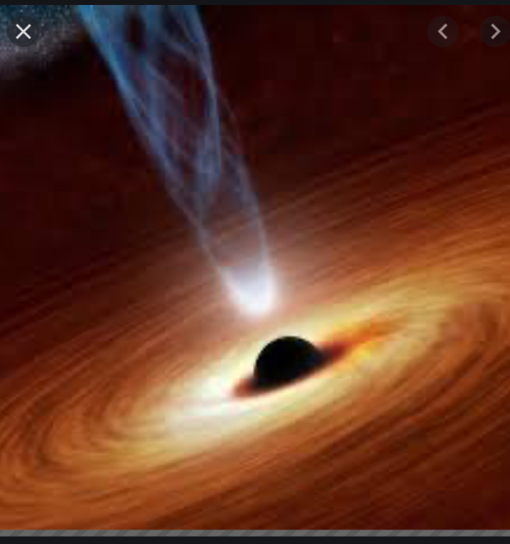
People think that art and science are not connected at all but they are wrong - science can make a cool looking art picture like this.
This is a picture that scientist made which represents a black hole in Space.
If you combine science and art it can make amazing stuff, things, pictures
People think that science and art are different things but if you find a way to make Science and Art work together, you may get great results like image on the right.

Slide 9
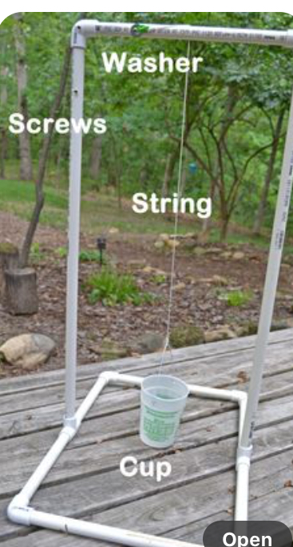
Pendulum panting
Pendulum panting Is mostly a science experiment because you get to see how a bottle can make art.
If you would want to make your own, all the stuff you need is in the video
If you want, you can tap on the video and watch it. This video is different way to make a pendulum pantings
If you want to see the set up, it looks like this

Slide 10
Mar 16 2016
Conclusion
Science and art are the same thing. Both science and art are human attempts to understand and describe the world around us, with motivations and goals fundamentally the same.

Slide 11
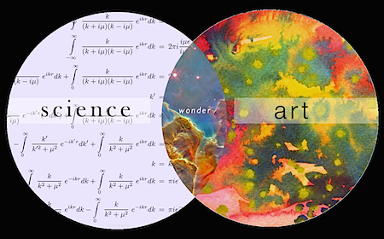
When science meets art wonders are possible
Mar 16th, 2016
Action

Slide 12
Thanks for listening
By Filip Zifra

