Slide 1
Exhibition
Ecology

Slide 2
In this presentation you will learn about some of the biggest and most dangerous natural disasters and also about effects on the environment and animals.

Slide 3
Central Idea:
Natural disasters and human activities can cause serious misbalance in the environment.

Slide 4
Line of inquiry:
Protecting the environment from disasters.

Slide 5
Team:
Luka,Una,Staša,
and me

Slide 6
Mentor:
Danica Simović

Slide 7
Teacher:
Katarina Milošević

Slide 8
Audience:
Our school,our parents,and our teachers.

Slide 9
7 ways to survive natural disasters
https://www.youtube.com/watch?v=OCjl6tp8dnw&feature=share
Published on 6th Jan, 2018

Slide 10
How to survive a Tornado and recognize it
https://youtu.be/wcTdLnrxznM
Published on 10th Dec, 2019

Slide 11
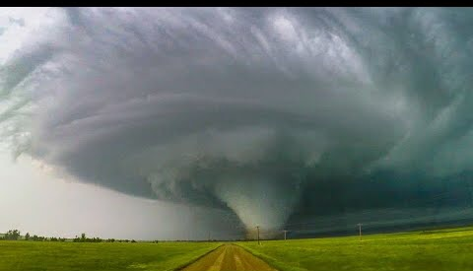
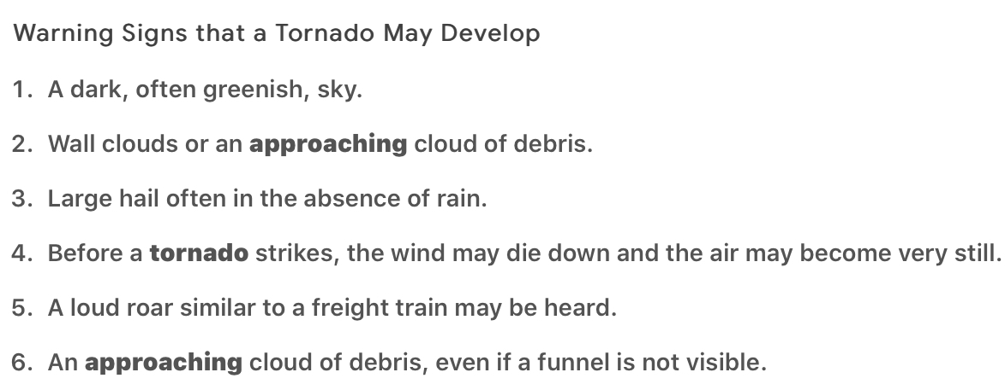
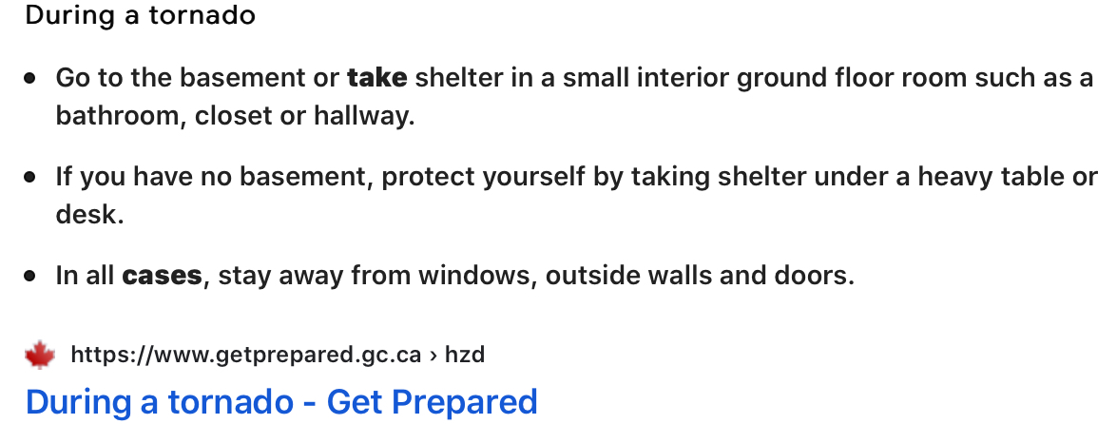
In this YouTube video I learned:
How to recognize when a Tornado 🌪 is coming.
What to do in case of a Tornado 🌪.

Slide 12
North Korean March of suffering
Deaths: around 3.500.000
Location: North Korea
Period: from 1994 to 1998
Consequences: starvation or hunger related to illness and economic breakdown.
It was a period of mass starvation together with economic crisis.

Slide 13
Great Bengal famine
Period: from 1769 to 1773
Location: Bengal
Country: India
Deaths:10 million
Cause: destruction of food crops.
Consequences: economic breakdown and deaths.
10 million people died of famine because the crops were destroyed.
Famine-starvation.

Slide 14
Central China flood
Year:1931
Deaths:4 million
Location: Central and eastern China
The flood destroyed huge amount of farmland and housing.
15% of rice and wheat crops were destroyed.
The Yellow,Yangtze,and Huai rivers of China flooded and almost inundated all of central China.
For protection the government has to build as many waterproof barriers as possible.

Slide 15
Egypt/Syria Earthquake
Start date:May 20,1202.
Deaths:1.1 million people.
Areas affected: Ayyubid Sultanate, Kingdom of Jerusalem.
Cause:The earthquake resulted from movement of the Dead Sea.
To protect yourself from an earthquake you need to hide in a underground shelter or under a strong table.

Slide 16
Coronavirus (Covid-19)
If you start to get the symptoms of the Coronavirus (Covid-19) make sure you go to the hospital 🏥. Don’t leave the house except to get medical care!
If you don’t have the Coronavirus (Covid-19) then stay home 🏠 and avoid big crowds.

Slide 17
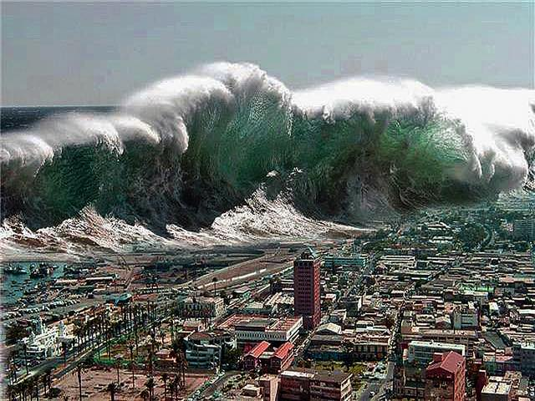
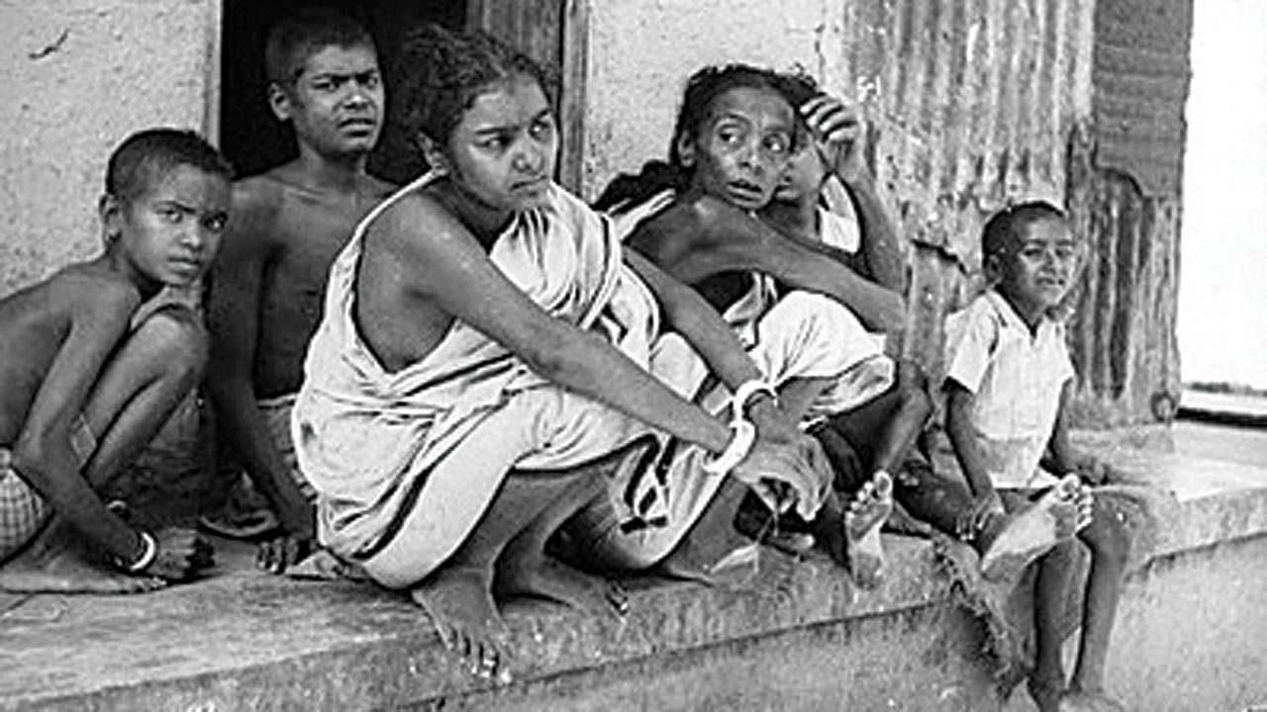
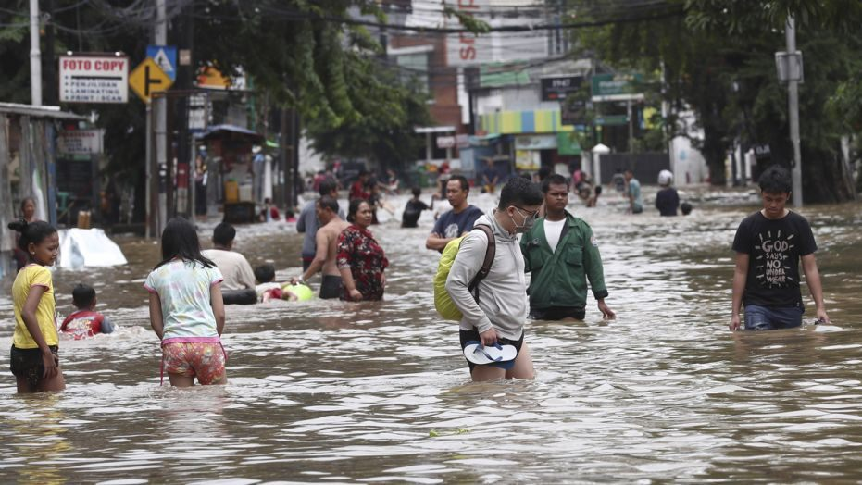
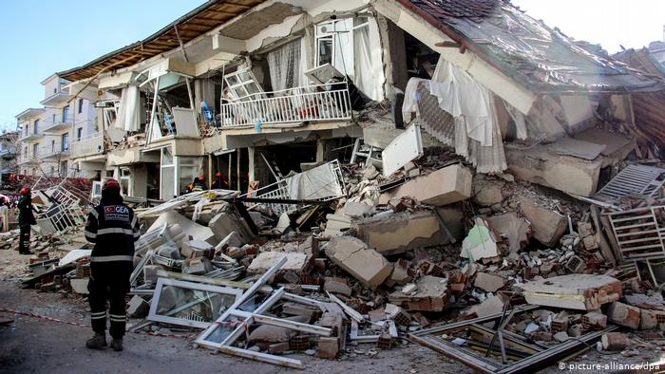

Slide 18
Earthquakes
Earthquakes are usually caused when a rock underground suddenly breaks.
Earthquakes are short (about 10 to 30 seconds) but while they last they can be very strong and the ground will shake!
The main cause of earthquakes are Volcano Eruptions!

Slide 19
Floods
Here are five most common causes of flooding,both natural and human:
1. The simplest explanation for flooding is heavy rain.
2. Overflowing Rivers.
3. Broken Dams.
4. Storms and Tsunamis.
5. Melting snow and ice.

Slide 20
Tsunami 🌊
Tsunamis are actually giant waves 🌊 caused by sudden movements of the ocean due to earthquakes.
This sudden motion could be an earthquake, a powerful volcanic eruption 🌋, or underwater landslide.

Slide 21
Volcanic eruptions 🌋
Volcanos 🌋 erupt when a molten rock called magma rises to the surface.
Magma is formed when the Earths mantle melts (omotač jezgra).

Slide 22
Tornados 🌪
Most tornadoes 🌪 form from thunderstorms.
When warm and cool air masses meet a tornado 🌪 forms.

Slide 23
Arctic ice 🧊 melting
When the polar ice 🧊 caps melt the Earth is absorbing more sunlight and getting even warmer.
The ice that was solid is turning to liquid and if all the ice were to melt the sea 🌊 level would rise about 70 meters.
The ocean would cover all coastal cities!
Warmer temperatures in the Arctic 🥶 are causing land-based ice in Greenland to melt as well!
In 2019 a project proved that in 2030 the sea level will rise 30 centimeters!

Slide 24
Australian bushfire 🔥
Bushfires can both be caused by human activity and naturally.
The bushfires in Australia seem to be both man-made and natural!
A 2008 study found that 85% of Australia’s fires 🔥 were man-made!
About 1billion animals burned during the Australian bushfires!

Slide 25
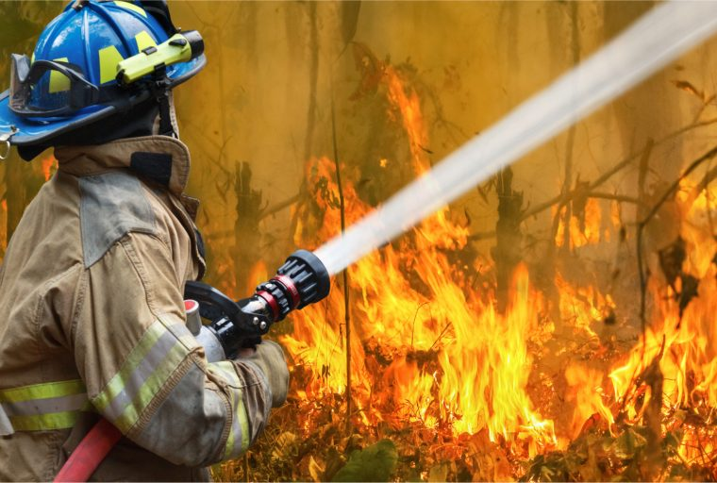
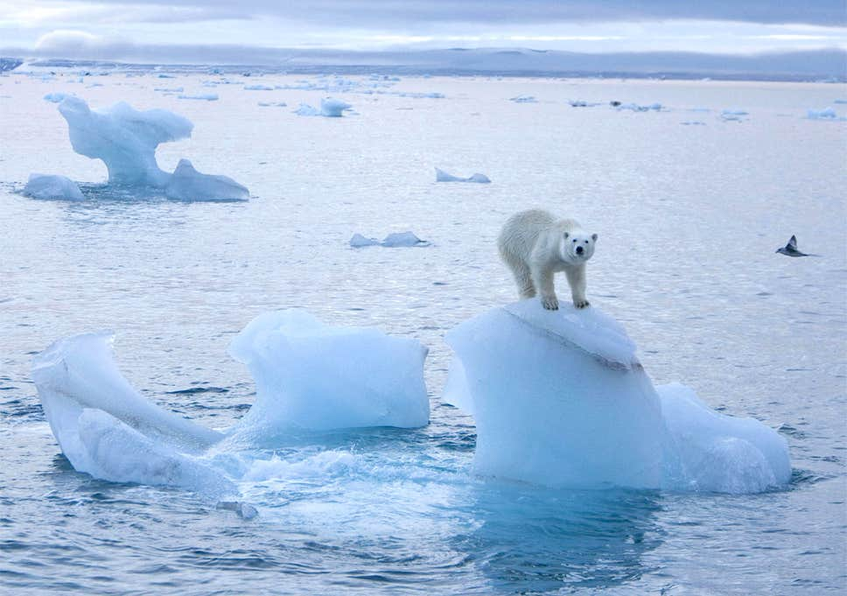
Scientist says giant
walls and cooling tunnels
might save the Arctic ice.
Regularly mowing the grass and raking up leaves 🍁 would prevent bushfires.
Houses need to have fireproof stairs and doors 🚪.

Slide 26
Ozone Layer
Ozone is a gas in the atmosphere that protects us and everything else on the planet. It also protects us from the harmful ultraviolet rays from the sun ☀️!
Avoid using gasses dangerous to the ozone layer!
Minimize the use of cars 🚗!
Do NOT use chemicals that are harmful to the environment!
The ozone layer is 3 millimeters thick.
In about five to seven years the ozone layer may be ruined!!!
If we don’t STOP 🛑 using chemicals the ozone layer will be ruined and without it people and animals will die.
The factory’s we buy products from produce a lot of smoke 💨. We breathe: nitrogen,oxygen,carbon dioxide... but we mostly breathe polluted air from: factories and cars...which is not good for us or the ozone layer!!!

Slide 27
Humans and animals
Humans and animals both need the sun and the ozone layer. Without the ozone layer the ultraviolet rays would burn us because they are very very hot 🥵. Without the sun we would freeze 🥶 to death within 7 to 8 minutes!

Slide 28
Facts about animals and natural disasters
Although scientists disagree that animals behavior can be used to predict earthquakes and other natural disasters they all agree that it is possible that animals sense changes in the environment before humans!

Slide 29
The effects of natural disasters on the lives of animals
Natural disasters have many consequences and devastating effect not only on people in the area but also animals that have made their homes there!
Many wild animals have to deal with seasonal events such as flooding and wildfires.... There are times when the animals can’t escape the disaster and suffering!
Many animals are left and abandoned during the disaster!
DO NOT leave your pets during a disaster! Because they have the best chance of surviving with you!

Slide 30
Links
https://www.dw.com/en/powerful-earthquake-strikes-eastern-turkey/a-52144249
https://www.thailandmedical.news/news/breaking-news-:-researchers-from-institut-of-pasteur-say-that-new-coronavirus-has-rapid-multiplication-capabilities-both-in-host-and-in-culture
https://en.wikipedia.org/wiki/1202_Syria_earthquake
https://en.m.wikipedia.org/wiki/1931_China_floods
https://en.wikipedia.org/wiki/Great_Bengal_famine_of_1770
https://en.wikipedia.org/wiki/Ozone_layer
https://en.wikipedia.org/wiki/North_Korean_famine
https://www.google.com/url?sa=t&rct=j&q=&esrc=s&source=web&cd=11&ved=2ahUKEwih8v2S8f7oAhVKxosKHSQmD8YQFjAKegQIDRAm&url=https%3A%2F%2Fwww.ga.gov.au%2Fscientific-topics%2Fcommunity-safety%2Fbushfire&usg=AOvVaw14fDG13zV4MH79jHzIceX0
https://www.nbcnews.com/mach/science/can-these-bold-plans-keep-world-s-ice-sheets-melting-ncna877616
https://www.weatherwizkids.com/
http://news.bbc.co.uk/cbbcnews/hi/find_out/guides/tech/volcanoes/newsid_1768000/
https://geology.com/articles/tsunami-geology.shtml
https://b-air.com/2018/02/common-causes-flooding/
http://www.geo.mtu.edu/UPSeis/why.html
https://www.google.com/search?q=australian+bushfire&client=safari&hl=en-rs&sxsrf=ALeKk00cGV3ilsrmN34eiM2XStAleBvySg:1587657784363&source=lnms&tbm=isch&sa=X&ved=2ahUKEwiNyYuS9v7oAhWktIsKHY12DH8Q_AUoAXoECA4QAw&biw=1173&bih=756#imgrc=yx7Prrtt6PRWKM
https://www.independent.co.uk/news/science/arctic-ice-melting-to-a-record-low-scientists-warn-8070049.html
https://www.goodnewsnetwork.org/might-able-stop-tsunamis-tracks-firing-sound-waves/
https://www.foxnews.com/world/thousands-caught-in-floods-in-indonesias-sinking-capital

Slide 31
THE END
THANK YOU FOR LISTENING

